Slide 1

Chapter 10 – Interfaces

Slide 2
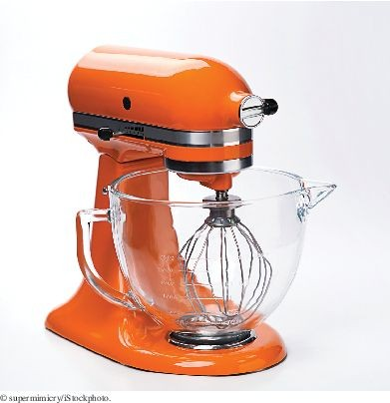
Chapter Goals
To be able to declare and use interface types
To appreciate how interfaces can be used to decouple classes To learn how to implement helper classes as inner classes
To implement event listeners in graphical applications

Slide 3

Using Interfaces for Algorithm Reuse
Interface types are used to express common operations.
Interfaces make it possible to make a service available to a wide set. This restaurant is willing to serve anyone who conforms to the Customer
interface with eat and pay methods.

Slide 4
Defining an Interface Type
Example: a method to compute the average of an array of Objects
The algorithm for computing the average is the same in all cases Details of measurement differ
Goal: write one method that provides this service.
We can't call getBalance in one case and getArea in another.
Solution: all object who want this service must agree on a getMeasure method
BankAccount's getMeasure will return the balance
Country's getMeasure will return the area
Now we implement a single average method that computes the sum:
sum = sum + obj.getMeasure();

Slide 5
Defining an Interface Type
Problem: we need to declare a type for obj
Need to invent a new type that describes any class whose objects can be measured.
An interface type is used to specify required operations (like getMeasure):
public interface Measurable
{
double getMeasure();
}
A Java interface type declares methods but does not provide their implementations.

Slide 6
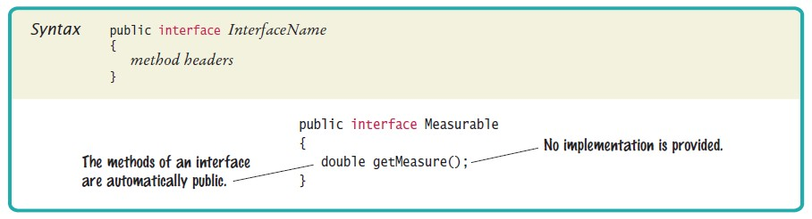
Syntax 10.1 Declaring an Interface

Slide 7
Defining an Interface Type
An interface type is similar to a class. Differences between classes and interfaces:
An interface type does not have instance variables.
All methods in an interface type are abstract (or in Java 8, static or default)
They have a name, parameters, and a return type, but no implementation.
All methods in an interface type are automatically public. An interface type has no constructor.
You cannot construct objects of an interface type.

Slide 8
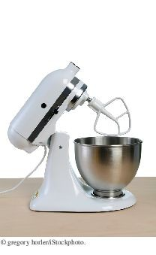
Defining an Interface Type
Implementing a reusable average method:
public static double average(Measurable[] objects)
{
double sum = 0;
for (Measurable obj : objects)
{
sum = sum + obj.getMeasure();
}
if (objects.length > 0) { return sum / objects.length; } else { return 0; }
}
This method is can be used for objects of any class that conforms to the
Measurable type.
This stand-mixer provides the “rotation” service to any attachment that conforms to a common interface. Similarly, the average method at the end of this section works with any class that implements a common interface.

Slide 9
Implementing an Interface Type
Use implements reserved word to indicate that a class implements an interface type:
public class BankAccount implements Measurable
{
...
public double getMeasure()
{
return balance;
}
}
BankAccount objects are instances of the Measurable type:
Measurable obj = new BankAccount(); // OK

Slide 10
Implementing an Interface Type
A variable of type Measurable holds a reference to an object of some class that implements the Measurable interface.
Country class can also implement the Measurable interface:
public class Country implements Measurable
{
public double getMeasure()
{
return area;
}
. . .
}
Use interface types to make code more reusable.

Slide 11
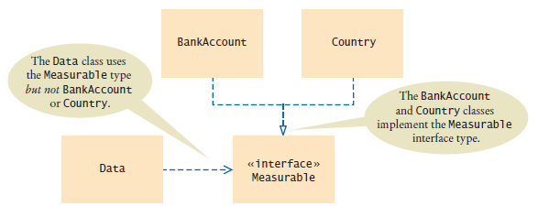
Implementing an Interface Type
Put the average method in a class - say Data
Figure 1 UML Diagram of the Data Class and the Classes that Implement the Measurable Interface
Data class is decoupled from the BankAccount and Country classes.

Slide 12
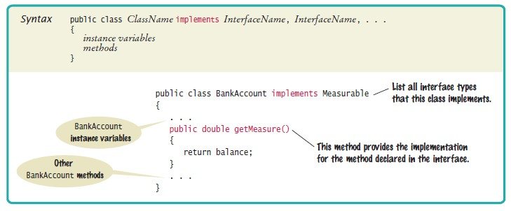
Syntax 10.2 Implementing an Interface

Slide 13
section_1/Data.java
1 public class Data
2 {
3 /**
Computes the average of the measures of the given objects.
@param objects an array of Measurable objects
@return the average of the measures
7 |  | */
8 |  | public static double average(Measurable[] objects)
9 |  | {
10 |  | double sum = 0;
11 |  | for (Measurable obj : objects)
12 |  | {
13 |  | sum = sum + obj.getMeasure();
14 |  | }
15 |  | if (objects.length > 0) { return sum / objects.length; }
16 |  | else { return 0; }
17 |  | }
18 | }

Slide 14
section_1/MeasurableTester.java
1 /**
2 This program demonstrates the measurable BankAccount and Country classes.
3 */
4 public class MeasurableTester
5 {
6 public static void main(String[] args)
7 {
Measurable[] accounts = new Measurable[3];
accounts[0] = new BankAccount(0);
accounts[1] = new BankAccount(10000);
accounts[2] = new BankAccount(2000);
12
13
14
15
16
17
18
19
20
21
22
23
24
25
26 }
double averageBalance = Data.average(accounts); System.out.println("Average balance: " + averageBalance); System.out.println("Expected: 4000");
Measurable[] countries = new Measurable[3]; countries[0] = new Country("Uruguay", 176220); countries[1] = new Country("Thailand", 513120); countries[2] = new Country("Belgium", 30510);
double averageArea = Data.average(countries); System.out.println("Average area: " + averageArea); System.out.println("Expected: 239950");
}
Program Run:
Average balance: 4000
Expected: 4000
Average area: 239950
Expected: 239950

Slide 15
Comparing Interfaces and Inheritance
Here is a different interface: Named
public interface Named
{
String getName();
}
A class can implement more than one interface:
public class Country implements Measurable, Named
A class can only extend (inherit from) a single superclass.
An interface specifies the behavior that an implementing class should supply (in Java 8, an interface can now supply a default implementation).
A superclass provides some implementation that a subclass inherits. Develop interfaces when you have code that processes objects of different classes in a common way.

Slide 16
Self Check 10.1
Suppose you want to use the average method to find the average salary of an array of Employee
objects. What condition must the Employee class fulfill?
Answer: It must implement the Measurable interface, and its getMeasure
method must return the salary.

Slide 17
Self Check 10.2
Why can’t the average method have a parameter variable of type Object[]?
Answer: The Object class doesn't have a getMeasure method, and the
average method invokes the getMeasure method.

Slide 18
Self Check 10.3
Why can’t you use the average method to find the average length of String objects?
Answer: You cannot modify the String class to implement Measurable
—String is a library class.

Slide 19
Self Check 10.4
What is wrong with this code?
Measurable meas = new Measurable(); System.out.println(meas.getMeasure());
Answer: Measurable is not a class. You cannot construct objects of type
Measurable.

Slide 20
Self Check 10.5
What is wrong with this code?
Measurable meas = new Country("Uruguay", 176220); System.out.println(meas.getName());
Answer: The variable meas is of type Measurable, and that type has no
getName method.

Slide 21
Converting From Classes to Interfaces
You can convert from a class type to an interface type, provided the class implements the interface.
A Measurable variable can refer to an object of the BankAccount class because BankAccount implements the Measurable interface:
BankAccount account = new BankAccount(1000); Measurable meas = account; // OK
A Measurable variable can refer to an object of the Country class because that class also implements the Measurable interface:
Country uruguay = new Country("Uruguay", 176220); Measurable meas = uruguay; // Also OK
A Measurable variable cannot refer to an object of the Rectangle class because Rectangle doesn't implement Measurable:
Measurable meas = new Rectangle(5, 10, 20, 30); // ERROR

Slide 22
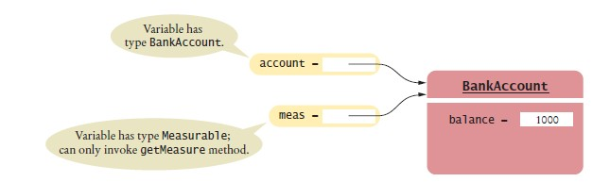
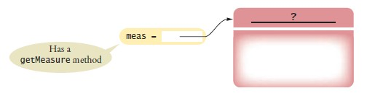
Variables of Class and Interface Types
Figure 2 Two references to the same object
Figure 3 An Interface Reference Can Refer to an Object of Any Class that Implements the Interface
Method calls on an interface reference are polymorphic. The appropriate method is determined at run time.

Slide 23
Casting from Interfaces to Classes
Method to return the object with the largest measure:
public static Measurable larger(Measurable obj1, Measurable obj2)
{
if (obj1.getMeasure() > obj2.getMeasure())
{
return obj1;
}
else
{
return obj2;
}
}
Returns the object with the larger measure, as a Measurable reference.
Country uruguay = new Country("Uruguay", 176220); Country thailand = new Country("Thailand", 513120); Measurable max = larger(uruguay, thailand);

Slide 24

Casting from Interfaces to Classes
You know that max refers to a Country object, but the compiler does not. Solution: cast
You need a cast to convert from an interface type to a class type.
If you are wrong and max doesn't refer to a Country object, the program throws an exception at runtime.
If a Person object is actually a Superhero, you need a cast before you can apply any Superhero methods.
Country maxCountry = (Country) max; String name = maxCountry.getName();

Slide 25
Self Check 10.6
Can you use a cast (BankAccount) meas to convert a Measurable variable meas to a BankAccount
reference?
Answer: Only if meas actually refers to a BankAccount object.

Slide 26
Self Check 10.7
If both BankAccount and Country implement the Measurable interface, can a Country reference be converted to a BankAccount reference?
Answer: No — a Country reference can be converted to a Measurable reference, but if you attempt to cast that reference to a BankAccount, an exception occurs.

Slide 27
Self Check 10.8
Why is it impossible to construct a Measurable object?
Answer: Measurable is an interface. Interfaces have no instance variables and no method implementations.

Slide 28
Self Check 10.9
Why can you nevertheless declare a variable whose type is Measurable?
Answer: That variable never refers to a Measurable object. It refers to an object of some class—a class that implements the Measurable interface.

Slide 29
Self Check 10.10
What does this code fragment print? Why is this an example of polymorphism?
Measurable[] data = { new BankAccount(10000), new Country("Belgium", 30510) }; System.out.println(average(data));
Answer: The code fragment prints 20255. The average method calls getMeasure on each object in the array. In the first call, the object is a BankAccount. In the second call, the object is a Country. A different getMeasure method is called in each case. The first call returns the account balance, the second one the area, which are then averaged.

Slide 30
The Comparable Interface
Comparable interface is in the standard Java library.
Comparable interface has a single method:
public interface Comparable
{
int compareTo(Object otherObject);
}
The call to the method:
a.compareTo(b)
The compareTo method returns:
a negative number if a should come before b, zero if a and b are the same
a positive number if b should come before a.
Implement the Comparable interface so that objects of your class can be compared, for example, in a sort method.

Slide 31
The Comparable Interface
BankAccount class' implementation of Comparable:
public class BankAccount implements Comparable
{
. . .
public int compareTo(Object otherObject)
{
BankAccount other = (BankAccount) otherObject; if (balance < other.balance) { return -1; }
if (balance > other.balance) { return 1; } return 0;
}
. . .
}
compareTo method has a parameter of reference type Object
To get a BankAccount reference:
BankAccount other = (BankAccount) otherObject;

Slide 32

The Comparable Interface
Because the BankAccount class implements the Comparable interface, you can sort an array of bank accounts with the Arrays.sort method:
BankAccount[] accounts = new BankAccount[3]; accounts[0] = new BankAccount(10000); accounts[1] = new BankAccount(0); accounts[2] = new BankAccount(2000); Arrays.sort(accounts);
Now the accounts array is sorted by increasing balance.
The compareTo method checks whether another object is larger or smaller.

Slide 33
Self Check 10.11
How can you sort an array of Country objects by increasing area?
Answer: Have the Country class implement the Comparable interface, as shown below, and call Arrays.sort.
public class Country implements Comparable
{
. . .
public int compareTo(Object otherObject)
{
Country other = (Country) otherObject; if (area < other.area) { return -1; } if (area > other.area) { return 1; } return 0;
}
}

Slide 34
Self Check 10.12
Can you use the Arrays.sort method to sort an array of String objects? Check the API documentation for the String class.
Answer: Yes, you can, because String implements the Comparable interface type.

Slide 35
Self Check 10.13
Can you use the Arrays.sort method to sort an array of Rectangle objects? Check the API documentation for the Rectangle class.
Answer: No. The Rectangle class does not implement the Comparable
interface.

Slide 36
Self Check 10.14
Write a method max that finds the larger of any two Comparable objects.
Answer:
public static Comparable max(Comparable a, Comparable b)
{
if (a.compareTo(b) > 0) { return a; } else { return b; }
}

Slide 37
Self Check 10.15
Write a call to the method of Self Check 14 that computes the larger of two bank accounts, then prints its balance.
Answer:
BankAccount larger = (BankAccount) max(first, second); System.out.println(larger.getBalance());
Note that the result must be cast from Comparable to BankAccount so that you can invoke the getBalance method.

Slide 38
Using Interfaces for Callbacks
Limitations of Measurable interface:
Can add Measurable interface only to classes under your control Can measure an object in only one way
E.g., cannot analyze a set of cars by both speed and price
Callback: a mechanism for specifying code that is executed at a later time. Problem: the responsibility of measuring lies with the added objects themselves.
Alternative: give the average method both the data to be averaged and a method of measuring.
Create an interface:
public interface Measurer
{
double measure(Object anObject);
}
All objects can be converted to Object.

Slide 39
Using Interfaces for Callbacks
The code that makes the call to the callback receives an object of class that implements this interface:
public static double average(Object[] objects, Measurer meas)
{
double sum = 0;
for (Object obj : objects)
{
sum = sum + meas.measure(obj);
}
if (objects.length > 0) { return sum / objects.length; } else { return 0; }
}
The average method simply makes a callback to the measure method whenever it needs to measure any object.

Slide 40
Using Interfaces for Callbacks
A specific callback is obtained by implementing the Measurer interface:
public class AreaMeasurer implements Measurer
{
public double measure(Object anObject)
{
Rectangle aRectangle = (Rectangle) anObject;
double area = aRectangle.getWidth() * aRectangle.getHeight(); return area;
}
}
Must cast from Object to Rectangle:
Rectangle aRectangle = (Rectangle) anObject;

Slide 41
Using Interfaces for Callbacks
To compute the average area of rectangles:
construct an object of the AreaMeasurer class and pass it to the average method:
Measurer areaMeas = new AreaMeasurer(); Rectangle[] rects
= { new Rectangle(5, 10, 20, 30), new Rectangle(10, 20, 30, 40) }; double averageArea = average(rects, areaMeas);
The average method will ask the AreaMeasurer object to measure the rectangles.

Slide 42
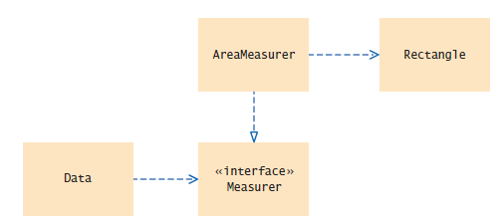
Using Interfaces for Callbacks
The Data class (which holds the average method) is decoupled from the class whose objects it processes (Rectangle).
You provide a small “helper” class AreaMeasurer, to process rectangles.
Figure 6 UML Diagram of the Data Class and the Measurer Interface

Slide 43
section_4/Measurer.java
1 /**
2 Describes any class whose objects can measure other objects.
3 */
4 public interface Measurer
5 {
6 /**
Computes the measure of an object.
@param anObject the object to be measured
@return the measure
10 */
11 double measure(Object anObject);
12 }

Slide 44
section_4/AreaMeasurer.java
1 import java.awt.Rectangle;
2
3 /**
4 Objects of this class measure rectangles by area.
5 */
6 public class AreaMeasurer implements Measurer
7 {
8 public double measure(Object anObject)
9 {
Rectangle aRectangle = (Rectangle) anObject;
double area = aRectangle.getWidth() * aRectangle.getHeight();
return area;
13 }
14 }

Slide 45
section_4/Data.java
1 public class Data
2 {
3 /**
Computes the average of the measures of the given objects.
@param objects an array of objects
@param meas the measurer for the objects
@return the average of the measures
8 */
9 public static double average(Object[] objects, Measurer meas)
10 {
double sum = 0;
for (Object obj : objects)
13 {
14 sum = sum + meas.measure(obj);
15 }
if (objects.length > 0) { return sum / objects.length; }
else { return 0; }
18 }
19 }

Slide 46
section_4/MeasurerTester.java
1 import java.awt.Rectangle;
2
3 /**
4 This program demonstrates the use of a Measurer.
5 */
6 public class MeasurerTester
7 {
8 public static void main(String[] args)
9 {
10 Measurer areaMeas = new AreaMeasurer();
11
12
13
14
15
16
17
18
19
20
21
22
23 }
Rectangle[] rects = new Rectangle[]
{
new Rectangle(5, 10, 20, 30),
new Rectangle(10, 20, 30, 40),
new Rectangle(20, 30, 5, 15)
};
double averageArea = Data.average(rects, areaMeas); System.out.println("Average area: " + averageArea); System.out.println("Expected: 625");
}
Program Run:
Average area: 625
Expected: 625

Slide 47
Self Check 10.16
Suppose you want to use the average method of Section 10.1 to find the average length of String
objects. Why can’t this work?
Answer: The String class doesn't implement the Measurable interface.

Slide 48
Self Check 10.17
How can you use the average method of this section to find the average length of String objects?
Answer: Implement a class StringMeasurer that implements the Measurer
interface.

Slide 49
Self Check 10.18
Why does the measure method of the Measurer interface have one more argument than the
getMeasure method of the Measurable interface?
Answer: A measurer measures an object, whereas getMeasure measures “itself”, that is, the implicit parameter.

Slide 50
Self Check 10.19
Write a method max with three arguments that finds the larger of any two objects, using a Measurer to compare them.
Answer:
public static Object max(Object a, Object b, Measurer m)
{
if (m.getMeasure(a) > m.getMeasure(b))
{
return a;
}
else { return b; }
}

Slide 51
Self Check 10.20
Write a call to the method of Self Check 19 that computes the larger of two rectangles, then prints its width and height.
Answer:
Rectangle larger = (Rectangle) max(first, second, areaMeas); System.out.println(larger.getWidth() + " by " + larger.getHeight());

Slide 52
Lambda Expressions
Using a method such as average is too much work
That's why you don't find many such methods in the standard library Java 8 makes this much easier: Use a lambda expression
Works with interfaces that have a single abstract method
Such interfaces are called functional interfaces...
...because instances are similar to mathematical functions
Lambda expression specifies:
Parameters
Code for computing the returned value
Example of a lambda expression: A function that gets the balance of a bank account
(Object obj) -> ((BankAccount) obj).getBalance()
Name “lambda expression” comes from a mathematical notation that uses the greek letter lambda (λ) instead of the -> symbol

Slide 53
Lambda Expressions 2
In Java, a lambda expression cannot stand alone.
It must be assigned to a variable whose type is a functional interface:
Measurer accountMeas =
(Object obj) -> ((BankAccount) obj).getBalance();
Now the following actions occur:
A class is defined that implements the functional interface. The single abstract method is defined by the lambda expression.
An object of that class is constructed.
The variable is assigned a reference to that object.
Can also pass lambda expression to a method:
double averageBalance = average(accounts,
(Object obj) –> ((BankAccount) obj).getBalance());
Then the parameter variable is initialized with the object

Slide 54

Inner Classes
Trivial class can be declared inside a method:
public class MeasurerTester
{
public static void main(String[] args)
{
class AreaMeasurer implements Measurer
{
. . .
}
. . .
Measurer areaMeas = new AreaMeasurer();
double averageArea = Data.average(rects, areaMeas);
. . .
}
}
An inner class is a class that is declared inside another class.

Slide 55
Inner Classes
You can declare inner class inside an enclosing class, but outside its methods. It is available to all methods of enclosing class:
public class MeasurerTester
{
class AreaMeasurer implements Measurer
{
. . .
}
public static void main(String[] args)
{
Measurer areaMeas = new AreaMeasurer();
double averageArea = Data.average(rects, areaMeas);
. . .
}
}
Compiler turns an inner class into a regular class file with a strange name:
MeasurerTester$1AreaMeasurer.class
Inner classes are commonly used for utility classes that should not be visible elsewhere in a program.

Slide 56
Self Check 10.21
Why would you use an inner class instead of a regular class?
Answer: Inner classes are convenient for insignificant classes. Also, their methods can access local and instance variables from the surrounding scope.

Slide 57
Self Check 10.22
When would you place an inner class inside a class but outside any methods?
Answer: When the inner class is needed by more than one method of the classes.

Slide 58
Self Check 10.23
How many class files are produced when you compile the MeasurerTester program from this section?
Answer: Four: one for the outer class, one for the inner class, and two for the
Data and Measurer classes.

Slide 59

Mock Objects
Problem: Want to test a class before the entire program has been completed.
A mock object provides the same services as another object, but in a simplified manner.
If you just want to practice arranging the Christmas decorations, you don’t need a real tree. Similarly, when you develop a computer program, you can use mock objects to test parts of your program.

Slide 60
Mock Objects
Example: a grade book application, GradingProgram, manages quiz scores using class GradeBook with methods:
public void addScore(int studentId, double score) public double getAverageScore(int studentId) public void save(String filename)
Want to test GradingProgram without having a fully functional GradeBook
class.
Declare an interface type with the same methods that the GradeBook class provides
Convention: use the letter I as a prefix for the interface name
public interface IGradeBook
{
void addScore(int studentId, double score); double getAverageScore(int studentId);
void save(String filename);
. . .
}

Slide 61
Mock Objects
Both the mock class and the actual class implement the same interface. The GradingProgram class should only use this interface, never the GradeBook class which implements this interface.
Meanwhile, provide a simplified mock implementation, restricted to the case of one student and without saving functionality:
public class MockGradeBook implements IGradeBook
{
private ArrayList<Double> scores;
public MockGradeBook() { scores = new ArrayList<Double>(); } public void addScore(int studentId, double score)
{
// Ignore studentId scores.add(score);
}
public double getAverageScore(int studentId)
{
double total = 0;
for (double x : scores) { total = total + x; } return total / scores.size();
}
public void save(String filename)
{
// Do nothing
}
. . .
}

Slide 62
Mock Objects
Now construct an instance of MockGradeBook and use it immediately to test the
GradingProgram class.
When you are ready to test the actual class, simply use a GradeBook instance instead.
Don’t erase the mock class — it will still come in handy for regression testing.

Slide 63
Self Check 10.24
Why is it necessary that the real class and the mock class implement the same interface type?
Answer: You want to implement the GradingProgram class in terms of that interface so that it doesn’t have to change when you switch between the mock class and the actual class.

Slide 64
Self Check 10.25
Why is the technique of mock objects particularly effective when the GradeBook and GradingProgram
class are developed by two programmers?
Answer: Because the developer of GradingProgram doesn’t have to wait for the GradeBook class to be complete.

Slide 65
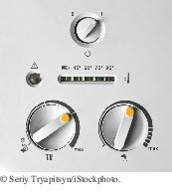
Event Handling
In an event-driven user interface, the program receives an event whenever the user manipulates an input component.
User interface events include key presses, mouse moves, button clicks, and so on.
Most programs don't want to be flooded by irrelevant events. A program must indicate which events it needs to receive.

Slide 66
Event Handling
Event listeners:
A program indicates which events it needs to receive by installing event listener objects Belongs to a class provided by the application programmer
Its methods describe the actions to be taken when an event occurs Notified when event happens
Event source:
User interface component that generates a particular event Add an event listener object to the appropriate event source
When an event occurs, the event source notifies all event listeners

Slide 67
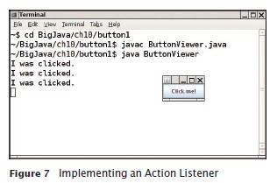
Events Handling
Example: A program that prints a message whenever a button is clicked. Button listeners must belong to a class that implements the ActionListener
interface:
public interface ActionListener
{
void actionPerformed(ActionEvent event);
}
Your job is to supply a class whose actionPerformed method contains the instructions that you want executed whenever the button is clicked.

Slide 68
section_7_1/ClickListener.java
import java.awt.event.ActionEvent;
import java.awt.event.ActionListener;
3
4
5
6
7
8
9
10
11
12
13
/**
An action listener that prints a message.
*/
public class ClickListener implements ActionListener
{
public void actionPerformed(ActionEvent event)
{
System.out.println("I was clicked.");
}
}

Slide 69
Event Handling - Listening to Events
event parameter of actionPerformed contains details about the event, such as the time at which it occurred.
Construct an object of the listener and add it to the button:
ActionListener listener = new ClickListener(); button.addActionListener(listener);
Whenever the button is clicked, it calls:
listener.actionPerformed(event);
And the message is printed. Similar to a callback
Use a JButton component for the button; attach an ActionListener to the button.

Slide 70
section_7_1/ButtonViewer.java
import java.awt.event.ActionListener;
import javax.swing.JButton;
import javax.swing.JFrame;
4
5
6
7
8
9
/**
This program demonstrates how to install an action listener.
*/
public class ButtonViewer
{

Slide 71
Using Inner Classes for Listeners
Implement simple listener classes as inner classes like this:
JButton button = new JButton(". . .");
// This inner class is declared in the same method as the button variable class MyListener implements ActionListener
{
. . .
}
ActionListener listener = new MyListener(); button.addActionListener(listener);
Advantages
Places the trivial listener class exactly where it is needed, without cluttering up the remainder of the project
Methods of an inner class can access instance variables and methods of the surrounding class:

Slide 72
Using Inner Classes for Listeners
Local variables that are accessed by an inner class method must be declared as
final (or in Java 8, effectively final [not modified after initialized]).
Example: add interest to a bank account whenever a button is clicked:
JButton button = new JButton("Add Interest"); frame.add(button);
final BankAccount account = new BankAccount(INITIAL_BALANCE);
class AddInterestListener implements ActionListener
{
public void actionPerformed(ActionEvent event)
{
// The listener method accesses the account variable
// from the surrounding block
double interest = account.getBalance() * INTEREST_RATE / 100; account.deposit(interest);
}
}
ActionListener listener = new AddInterestListener(); button.addActionListener(listener);

Slide 73
section_7_2/InvestmentViewer1.java
import java.awt.event.ActionEvent;
import java.awt.event.ActionListener;
import javax.swing.JButton;
import javax.swing.JFrame;
5
6
7
8
9
10
11
12
13
14
15
16
17
18
19
20
21
22
23
24
25
26
27
28
29
30
31
32
33
34
35
/**
This program demonstrates how an action listener can access a variable from a surrounding block.
*/
public class InvestmentViewer1
{
private static final int FRAME_WIDTH = 120; private static final int FRAME_HEIGHT = 60;
private static final double INTEREST_RATE = 10; private static final double INITIAL_BALANCE = 1000;
public static void main(String[] args)
{
JFrame frame = new JFrame();
// The button to trigger the calculation
JButton button = new JButton("Add Interest"); frame.add(button);
// The application adds interest to this bank account
final BankAccount account = new BankAccount(INITIAL_BALANCE);
class AddInterestListener implements ActionListener
{
public void actionPerformed(ActionEvent event)
{
// The listener method accesses the account variable
// from the surrounding block
Program Run:
balance: 1100.0
balance: 1210.0
balance: 1331.0
balance: 1464.1
double interest = account.getBalance() * INTEREST_RATE / 100;

Slide 74
Self Check 10.26
Which objects are the event source and the event listener in the ButtonViewer program?
Answer: The button object is the event source. The listener object is the event listener.

Slide 75
Self Check 10.27
Why is it legal to assign a ClickListener object to a variable of type ActionListener?
Answer: The ClickListener class implements the ActionListener
interface.

Slide 76
Self Check 10.28
When do you call the actionPerformed method?
Answer: You don’t. It is called whenever the button is clicked.

Slide 77
Self Check 10.29
Why would an inner class method want to access a variable from a surrounding scope?
Answer: Direct access is simpler than the alternative — passing the variable as an argument to a constructor or method.

Slide 78
Self Check 10.30
If an inner class accesses a local variable from a surrounding scope, what special rule applies?
Answer: The local variable must not change. Prior to Java 8, it must be declared as final.

Slide 79
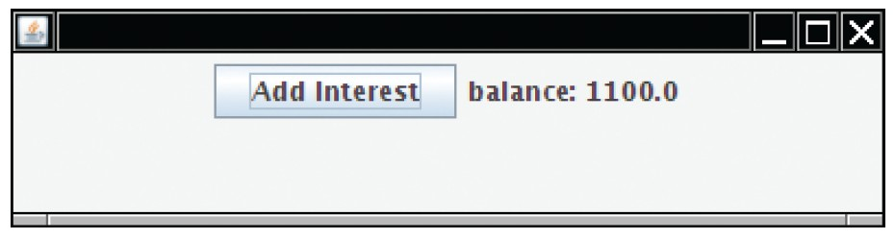
Building Applications with Buttons
Example: investment viewer program; whenever button is clicked, interest is added, and new balance is displayed:
Construct an object of the JButton class:
JButton button = new JButton("Add Interest");
We need a user interface component that displays a message:
JLabel label = new JLabel("balance: " + account.getBalance());
Use a JPanel container to group multiple user interface components together:
JPanel panel = new JPanel(); panel.add(button); panel.add(label); frame.add(panel);

Slide 80

Event Handling
Whenever a button is pressed, the actionPerformed method is called on all listeners.
Specify button click actions through classes that implement the ActionListener interface.

Slide 81
Building Applications with Buttons
AddInterestListener class adds interest and displays the new balance:
class AddInterestListener implements ActionListener
{
public void actionPerformed(ActionEvent event)
{
double interest = account.getBalance() * INTEREST_RATE / 100; account.deposit(interest);
label.setText("balance=" + account.getBalance());
}
}
Add AddInterestListener as inner class so it can have access to surrounding variables (prior to Java 8, account and label must be declared final).

Slide 82
section_8/InvestmentViewer2.java
import java.awt.event.ActionEvent;
import java.awt.event.ActionListener;
import javax.swing.JButton;
import javax.swing.JFrame;
import javax.swing.JLabel;
import javax.swing.JPanel;
7
8
9
/**
This program displays the growth of an investment.

Slide 83
Self Check 10.31
How do you place the "balance: . . ." message to the left of the "Add Interest" button?
Answer: First add label to the panel, then add button.

Slide 84
Self Check 10.32
Why was it not necessary to declare the button variable as final?
Answer: The actionPerformed method does not access that variable.

Slide 85
Processing Timer Events
javax.swing.Timer generates equally spaced timer events, sending events to installed action listeners.
Useful whenever you want to have an object updated in regular intervals. Declare a class that implements the ActionListener interface:
class MyListener implements ActionListener
{
void actionPerformed(ActionEvent event)
{
Listener action (executed at each timer event)
}
}
To create a timer, specify the frequency of the events and an object of a class that implements the ActionListener interface:
MyListener listener = new MyListener(); Timer t = new Timer(interval, listener); t.start();

Slide 86
section_9/RectangleComponent.java
Displays a rectangle that moves
The repaint method causes a component to repaint itself. Call this method whenever you modify the shapes that the paintComponent method draws.
import java.awt.Graphics;
import java.awt.Graphics2D;
import java.awt.Rectangle;
import javax.swing.JComponent;
5
6
7
8
9
/**
This component displays a rectangle that can be moved.
*/
public class RectangleComponent extends JComponent

Slide 87
section_9/RectangleFrame.java
import java.awt.event.ActionEvent;
import java.awt.event.ActionListener;
import javax.swing.JFrame;
import javax.swing.Timer;
5
6
7
8
9
/**
This frame contains a moving rectangle.
*/
public class RectangleFrame extends JFrame

Slide 88
section_9/RectangleViewer.java
1 import javax.swing.JFrame;
2
3 /**
4 This program moves the rectangle.
5 */
6 public class RectangleViewer
7 {
8 public static void main(String[] args)
9 {

Slide 89
Self Check 10.33
Why does a timer require a listener object?
Answer: The timer needs to call some method whenever the time interval expires. It calls the actionPerformed method of the listener object.

Slide 90
Self Check 10.34
What would happen if you omitted the call to repaint in the moveBy method?
Answer: The moved rectangles won't be painted, and the rectangle will appear to be stationary until the frame is repainted for an external reason.

Slide 91
Mouse Events
Use a mouse listener to capture mouse events.
Implement the MouseListener interface which has five methods:
public interface MouseListener
{
void mousePressed(MouseEvent event);
// Called when a mouse button has been pressed on a component void mouseReleased(MouseEvent event);
// Called when a mouse button has been released on a component void mouseClicked(MouseEvent event);
// Called when the mouse has been clicked on a component void mouseEntered(MouseEvent event);
// Called when the mouse enters a component void mouseExited(MouseEvent event);
// Called when the mouse exits a component
}

Slide 92
Mouse Events
Add a mouse listener to a component by calling the addMouseListener
method:
public class MyMouseListener implements MouseListener
{
// Implements five methods
}
MouseListener listener = new MyMouseListener(); component.addMouseListener(listener);
Sample program: enhance RectangleComponent – when user clicks on rectangle component, move the rectangle to the mouse location.

Slide 93
section_10/RectangleComponent2.java
First add a moveRectangle method to RectangleComponent:
import java.awt.Graphics;
import java.awt.Graphics2D;
import java.awt.Rectangle;
import javax.swing.JComponent;
5
6
7
8
9
/**
This component displays a rectangle that can be moved.
*/
public class RectangleComponent2 extends JComponent

Slide 94
Mouse Events
Call repaint to tell the component to repaint itself and show the rectangle in its new position.
When the mouse is pressed,the mouse listener moves the rectangle to the mouse location:
class MousePressListener implements MouseListener
{
public void mousePressed(MouseEvent event)
{
int x = event.getX(); int y = event.getY(); component.moveTo(x, y);
}
// Do-nothing methods
public void mouseReleased(MouseEvent event) {} public void mouseClicked(MouseEvent event) {} public void mouseEntered(MouseEvent event) {} public void mouseExited(MouseEvent event) {}
}
All five methods of the interface must be implemented; unused methods can be empty.

Slide 95
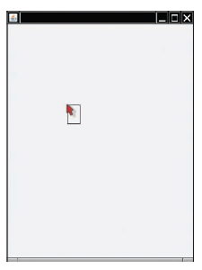
RectangleViewer2 Program Run
Figure 9 Clicking the Mouse Moves the Rectangle

Slide 96
section_10/RectangleFrame2.java
import java.awt.event.MouseListener;
import java.awt.event.MouseEvent;
import javax.swing.JFrame;
4
5
6
7
8
9
/**
This frame contains a moving rectangle.
*/
public class RectangleFrame2 extends JFrame
{

Slide 97
section_10/RectangleViewer2.java
1 import javax.swing.JFrame;
2
3 /**
4 This program displays a rectangle that can be moved with the mouse.
5 */
6 public class RectangleViewer2
7 {
8 public static void main(String[] args)
9 {

Slide 98
Self Check 10.35
Why was the moveRectangleBy method in the RectangleComponent replaced with a
moveRectangleTo method?
Answer: Because you know the current mouse position, not the amount by which the mouse has moved.

Slide 99
Self Check 10.36
Why must the MousePressListener class supply five methods?
Answer: It implements the MouseListener interface, which has five methods.

